Slide 1

Action Script

Slide 2
Action Script
Action Script enables interactivity, data handling,
and much more in Flash, Flex, and AIR content and
applications.
It is designed to facilitate the creation of highly
complex applications with large data sets
and object-oriented, reusable code bases

Slide 3

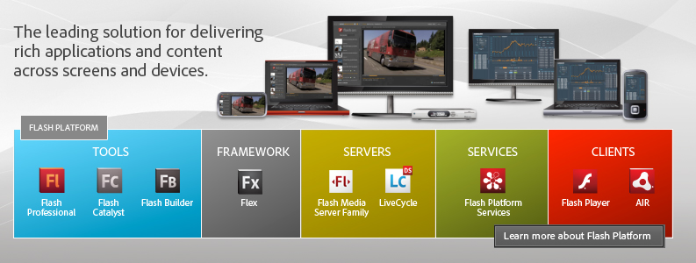
The Flash Platform

Slide 4


Features
Two Popular Versions
  AS3
  AS2 (Deprecated)
Based on ECMAScript
  ECMA 262
  ECMAScript for XML (E4X)
Compiled into a AS ByteCode
Dynamic and static typing

Slide 5

Features
Object Oriented Language
Event-Driven
DOM Compliant
  Based on the Document Object Model (DOM) Level 3 Events Specification
Virtual Machines
  Flash Player
  Air Runtime
  GNU Gnash (Open Source)

Slide 6

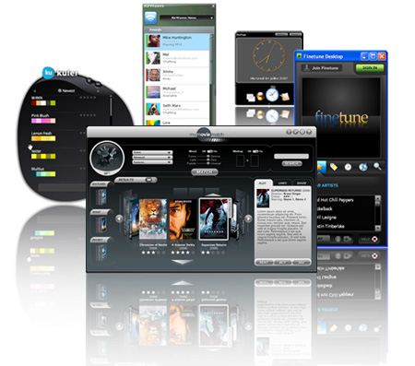
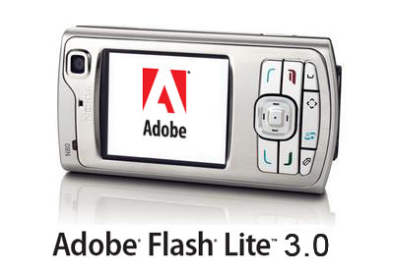
One Language, any device…
Designed to provide an easy way to develop Mobile, Web and Desktop Applications

Slide 7






Development Toolkit
Flash Builder (Flex Builder)
Adobe Flash Professional
Flash Develop
Plugins For Eclipse
  http://axdt.org/
  http://www.codedrive.com/
Nano, VI, Notepad++…

Slide 8

Action Script 3.0
The latest version of the language
10 times faster than the other versions
More Helpful Classes
Performance Improvements
Improved object-oriented programming
Improved Run-time exceptions
Run-time types

Slide 9
Action Script 3.0
Sealed Classes
ECMAScript for XML (E4X)
Regular Expressions
Namespaces
New Primitive types
Display List API

Slide 10
Action Script Basics
TimeLine Handling
Frame Code Vs Class Code
Creating Objects
Garbage Collector
Functions
Classes
Getters y setters

Slide 11
Action Script Basics
Packages
The Class Initializer
Listen For Events
Display API

Slide 12
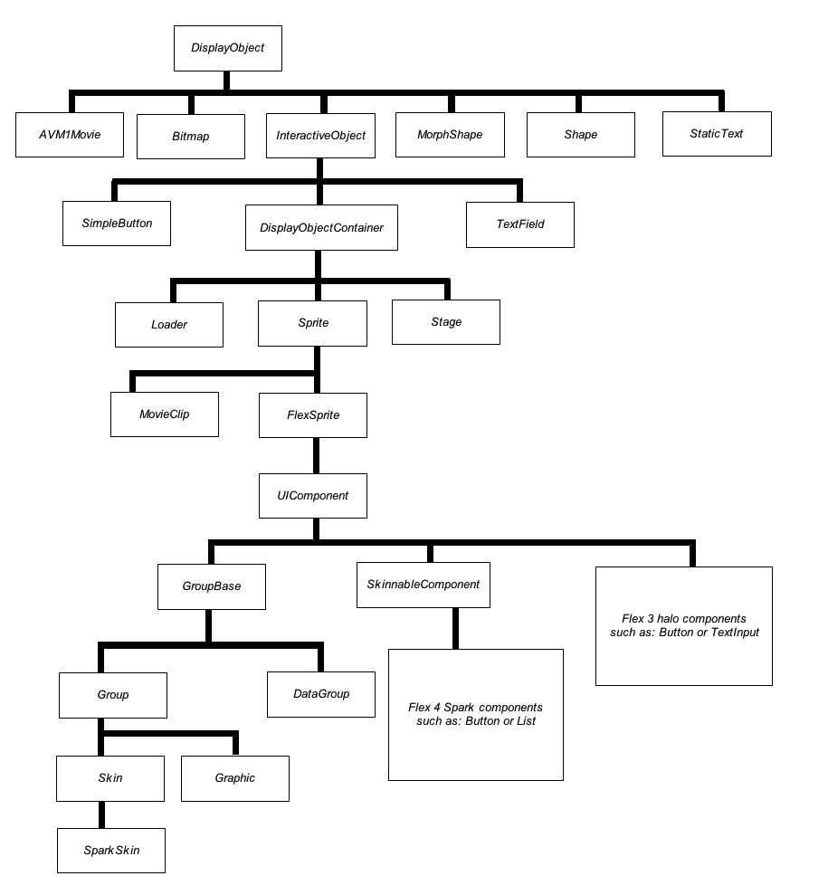
Display
API

Slide 13
Action Script Basics
Handling Animations

Slide 14
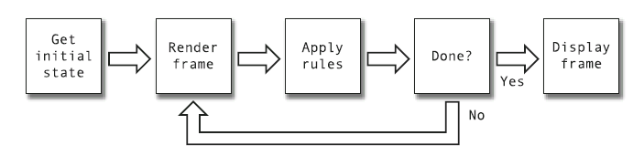
Looping
The flowchart shows how flash handles an animation

Slide 15

The Dark Side…
No abstract Class support
Can’t overload methods
It´s closed-source and needs a plug-in
Runs on a Virtual Machine… you know the consequences
Although AS follows a sandbox model, it isn’t difficult to break it.

Slide 16
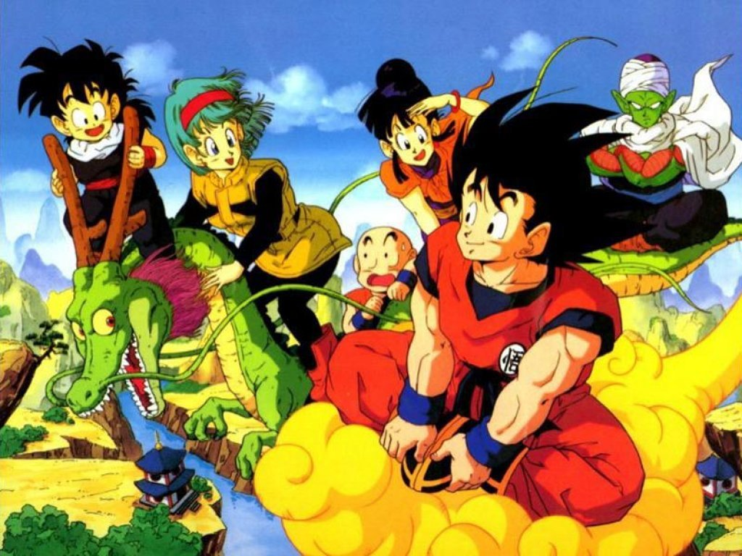
QUESTIONS???
I assume that there aren’t…

Slide 17


